Slide 1

Applied Distributed Systems
Infrastructure Security 1

Slide 2
Overview
What is security?
Cryptography
Public Key Infrastructure
Certificates

Slide 3
Basic security definition
Short (but memorable form) - CIA
Confidentiality
Integrity
Availability

Slide 4
More precise security definition
Authentication: assurance that communicating entity is the one claimed
Authorization: prevention of the unauthorized use of a resource
Data Confidentiality protection of data from unauthorized disclosure
Data Integrity assurance that data read or received is as written or sent by an authorized entity
Non-Repudiation protection against denial by one of the parties in a communication
Availability – resource accessible/usable

Slide 5
Data
One more concept – data
At rest – on disk or in memory
In transit - on the network

Slide 6
Overview
What is security?
Cryptography
Public Key Infrastructure
Certificates

Slide 7
Cryptography
Three forms of encryption
Symmetric
Asymmetric
One way - hash
NIST (US National Institute for Science and Technology) certifies algorithms and implementations for encryption.

Slide 8

Symmetric encryption
Use same key for encrypting and decrypting
Suitable for data at rest
A portion of solution for data in transit.
NIST approved algorithm is AES with key lengths of >128 bits

Slide 9
Weaknesses of Symmetric encryption
If attacker discovers key, they have access to all encrypted data
No authentication with symmetric encryption

Slide 10
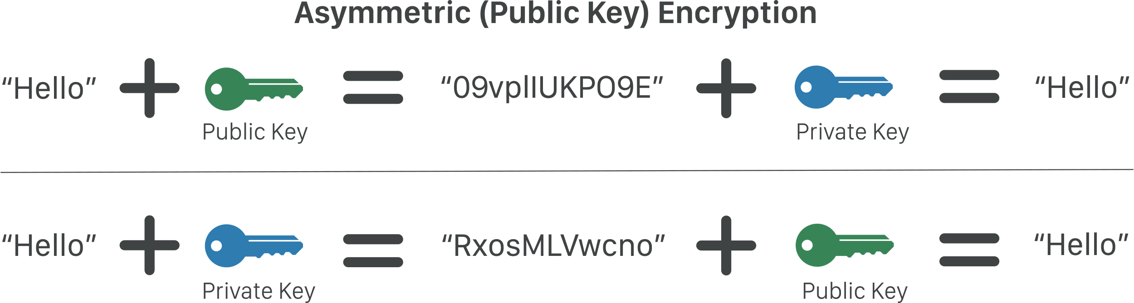
Asymmetric Encryption
Also known as public/private key encryption
Messages encrypted with public key can be decrypted by private key (and vice versa)
NIST approved algorithms: DSA, RSA, ECDSA >1024 bits
Private key
Public key

Slide 11
Hashing
A hash is a one way encryption based on a public algorithm with no key
Not possible (very difficult) to decrypt
Used to verify integrity of data
Passwords: save hash of password but not password. When user enters password, compare to hash to verify.
Downloads: publish hash of software available for download. Compare hash of downloaded software. Verifies that software has not been modified.
NIST approved algorithm is SHA-3.

Slide 12
Overview
What is security?
Cryptography
Public Key Infrastructure
Certificates

Slide 13
Public Key Infrastructure (PKI)
PKI is based on asymmetric encryption using public and private keys
Public key is known to everyone
Private key is known only to you

Slide 14
Use of PKI in Messages
Message sent to you is encrypted with your public key. Only you can read it
Message sent by you is encrypted with your private key. Decrypting it with your public key guarantees that you sent it

Slide 15
Overview
What is security?
Cryptography
Public Key Infrastructure
Certificates

Slide 16
Certificates
Certificates are used to establish that a web site is what it claims to be.
Certificates are based on PKI
Two important elements of a certificate
URL of web site that has been certified
Digital signature of a trusted certificate authority
Certificates are signed by “Certificate Authority” (CA)

Slide 17
Digital signature
A digital signature is used to verify that text is
Sent by known entity
Not changed during transmission
Message is text+encrypted hash of text
Hash is encrypted using private key of signing entity
Encrypted hash can only be decrypted using public key of signing entity
Hash is used to verify that text has not been changed
Notes:
know

Slide 18




Getting a certificate
Registers web site
Trusted Certificate Authority
Bob
Trusted Certificate Authority
Bob
Certificate digitally signed by CA

Slide 19


Accessing Web Site
Accesses Bob’s web site
Alice
Alice verifies using CA’s public key (saved in her browser) and knows she is talking to Bob’s web site

Slide 20
Summary
Security is CIA + authentication + authorization + non-repudiation
Three different encryption styles.
Symmetric
Asymmetric
Hashing
PKI is based on Asymmetric Encryption and is the basis for certificates to validate web sites.

